Slide 1

Risk Management
Software Engineering: A Practitioner’s Approach, 7/e
by Roger S. Pressman

Slide 2

Project Risks
What can go wrong?
ISSUE
What is the likelihood?
PROBABILITY of OCCURECNCE
What will the damage be?
IMPACT
What can we do about it?
MITIGATION

Slide 3
Risk Mangement
project team reacts to risks when they occur
Mitigation - plan for additional resources in anticipation
fix on failure — resource are found and applied when the risk strikes
crisis management — how to recover if the project encounters an event leading to project failure

Slide 4
Risk Mangement
formal risk analysis is performed
organization corrects the root causes of risk
examining risk sources that lie beyond the bounds of the software
developing the skill to manage change

Slide 5
7 principles to avoid project failure
Maintain a global perspective—identify all the software risks in the scope of application
Take a forward-looking view—establish plan B in case of risk occurrence
Encourage open communication—if someone states a potential risk, don’t discount it.
Integrate—risk consideration integrated in software development
Emphasize a continuous process—the team is continuously monitoring for evolving risks and their mitigation plans, incase of occurrence.
Develop a shared product vision—if scope is same for all product owners, then risk assessment done should be more valuable and all are on same page.
Encourage teamwork—the talents, skills and knowledge of all stakeholder should be pooled

Slide 6
Risk Management paradigm
control
Identify
analyze
Plan
track

Slide 7
Risk identification
Product size—risks arise with the overall size of the software to be built or modified.
Business impact—risks arise because of management and marketplace constraints.
Customer characteristics—Risks arise when customers are not very knowledgeable or when developers struggle to communicate with them promptly.
Process definition—risks associated with the defined software process followed by the development organization.
Development environment—risks associated with the availability and quality of the tools to be used to build the product.
Technology to be built—risks associated with the complexity of the system to be built and the "newness" of the technology that is packaged by the system.
Staff size and experience—risks associated with the overall technical and project experience of the software engineers who will do the work.

Slide 8
Risk due to project Size
Attributes that affect risk:
Estimates size of product in terms of LOC or FP,in number of programs, file or transactions
% deviation in size of product from average of previous products
Size of database in the product
Number of users
Number of changes cater before & after delivery
Amount of reused software

Slide 9
Risk due to business impact
Attributes that affect risk:
Effect of product on company’s revenue
Are delivery deadlines reasonable?
Interoperability constraints
No. of users
Sophistication of end users
Govt. constraints
Cost with late delivery
Cost with a defective product

Slide 10
Risk due to customer
Attributes that affect risk:
Does the customer know requirements well?
Is customer willing to give time to technical team
Is customer participating in reviews?
Is customer technically sound?
Does customer understand software engineering practices

Slide 11
Risk due to process maturity
Attributes that affect risk:
A process framework established?
Are teams following it?
Management support for SE practices?
Proactive approach to SQA
Conduct technical reviews?
Documentation formats established?

Slide 12
Technology risks
Attributes that affect risk:
The technology new to organization?
New algo. or I/O techniques used?
New or improved hardware?
Specialized UI requirement?
Application radically different?
New SE methods used?
Significant performance constraints?
The functionality asked is doubtfully doable

Slide 13
Staff/people risk
Attributes that affect risk:
Best people available?
Staff with right skillset?
Enough people availability?
Committed and dedicated workforce?
Necessary training received ?
Turnover among staff will be low?

Slide 14
Assessing project risk

Slide 15
Assessing project risk
Have top software and customer managers formally committed to support the project?
Are end-users enthusiastically committed to the project and the system/product to be built?
Are requirements fully understood by the SE team and their customers?
Have customers been involved fully in the definition of requirements?
Do end-users have realistic expectations?
Is project scope stable?
Does the software engineering team have the right mix of skills?
Are project requirements stable?
Does the project team have experience with the technology to be implemented?
Is the number of people on the project team adequate to do the job?
Do all customer/user constituencies agree on the importance of the project and on the requirements for the system/product to be built?

Slide 16
Risk components

Slide 17
Risk components
performance risk—the degree of uncertainty that the product will meet its requirements and be fit for its intended use.
cost risk—the degree of uncertainty that the project budget will be maintained.
support risk—the degree of uncertainty that the resultant software will be easy to correct, adapt, and enhance.
schedule risk—the degree of uncertainty that the project schedule will be maintained, and that the product will be delivered on time.

Slide 18
Risk Estimation

Slide 19
Risk Estimation
Risk estimation attempts to rate each risk in two ways
the probability that the risk is real
the consequences/impact of the problems associated with the risk, should it occur.

Slide 20
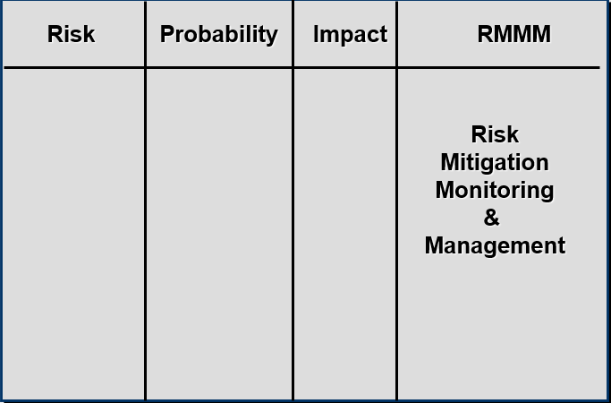
Building a risk table

Slide 21
Building a risk table
Estimate the probability of occurrence
Estimate the impact on the project on a scale of 1 to 5, where
1 = low impact on project success
5 = catastrophic impact on project success
sort the table by probability and impact

Slide 22
Building a risk table
The overall risk exposure or impact, RE, is determined using the following relationship:
RE = P x C
where
P is the probability of occurrence for a risk, and
C is the cost to the project should the risk occur.

Slide 23
Building a risk table
Risk identification. Only 70 percent of the software components scheduled for reuse will, in fact, be integrated into the application. The remaining functionality will have to be custom developed.
Risk probability. 80% (likely).
Risk impact. 60 reusable software components were planned. If only 70 percent can be used, 18 components would have to be developed from scratch (in addition to other custom software that has been scheduled for development). Since the average component is 100 LOC and local data indicate that the software engineering cost for each LOC is $14.00, the overall cost (impact) to develop the components would be 18 x 100 x 14 = $25,200.
Risk exposure. RE = 0.80 x 25,200 ~ $20,200.

Slide 24
Risk mitigation, monitoring & management
mitigation—how can we avoid the risk?
monitoring—what factors can we track that will enable us to determine if the risk is becoming more or less likely?
management—what contingency plans do we have if the risk becomes a reality?

Slide 25
Recording risk information

Slide 26
